Slide 1

AWS web services
Module-2 networking services
DAYANANDA SAGAR UNIVERSITY

Slide 2
Module 2
Storage and Virtual Private Cloud: AWS Storage – S3 architecture, Durability and Availability, Object Lifecycle, Accessing S3 objects, Amazon S3 Glazier, other storage, AWS CLI Example, VPC – CIDR blocks, Subnets, Elastic Network Interfaces, Internet Gateways, Route Tables, Security groups, Network Access Control Lists, Public IP Addresses, Elastic IP Addresses, NAT, VPC peering.
Textbook 1: Chapter 3: 59-75, Chapter 4:83-114

Slide 3
Several Historical Trends
Shared Utility Computing
  1960s – MULTICS – Concept of a Shared Computing Utility
  1970s – IBM Mainframes – rent by the CPU-hour. (Fast/slow switch.)
Data Center Co-location
  1990s-2000s – Rent machines for months/years, keep them close to the network access point and pay a flat rate. Avoid running your own building with utilities!
Pay as You Go
  Early 2000s - Submit jobs to a remote service provider where they run on the raw hardware. Sun Cloud ($1/CPU-hour, Solaris +SGE) IBM Deep Capacity Computing on Demand (50 cents/hour)
Virtualization
  1960s – OS-VM, VM-360 – Used to split mainframes into logical partitions.
  1998 – VMWare – First practical implementation on X86, but at significant performance hit.
  2003 – Xen paravirtualization provides much perf, but kernel must assist.
  Late 2000s – Intel and AMD add hardware support for virtualization.

Slide 4
Virtual-* Allows for the Scale of Abstraction to Increase Over Time
Run one process within certain resource limits.
  Op Sys has virtual memory, virtual CPU, and virtual storage (file system).
Run multiple processes within certain resource limits.
  Resource containers (Solaris), virtual servers (Linux), virtual images (Docker)
Run an entire operating system within certain limits.
  Virtual machine technology: VMWare, Xen, KVM, etc.
Run a set of virtual machines connected via a private network.
  Virtual networks (SDNs) provision bandwidth between virtual machines.
Run a private virtual architecture for every customer.
  Automated tools replicate virtual infrastructure as needed.

Slide 5
Amazon AWS
Grew out of Amazon’s need to rapidly provision and configure machines of standard configurations for its own business.
Early 2000s – Both private and shared data centers began using virtualization to perform “server consolidation”
2003 – Internal memo by Chris Pinkham describing an “infrastructure service for the world.”
2006 – S3 first deployed in the spring, EC2 in the fall
2008 – Elastic Block Store available.
2009 – Relational Database Service
2012 – DynamoDB
Does it turn a profit?

Slide 6
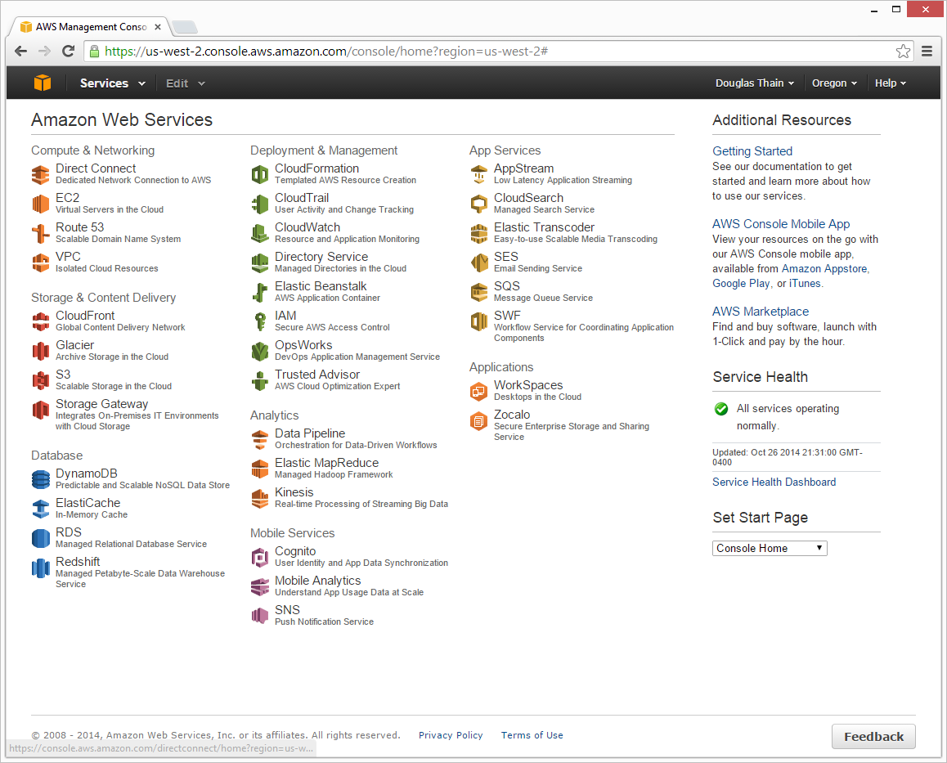

Slide 7
Terminology
Instance = One running virtual machine.
Instance Type = hardware configuration: cores, memory, disk.
Instance Store Volume = Temporary disk associated with instance.
Image (AMI) = Stored bits which can be turned into instances.
Key Pair = Credentials used to access VM from command line.
Region = Geographic location, price, laws, network locality.
Availability Zone = Subdivision of region the is fault-independent.

Slide 8
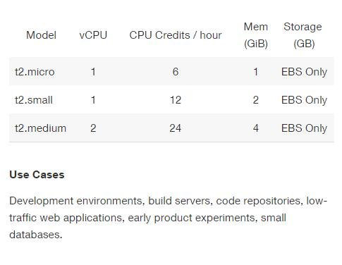
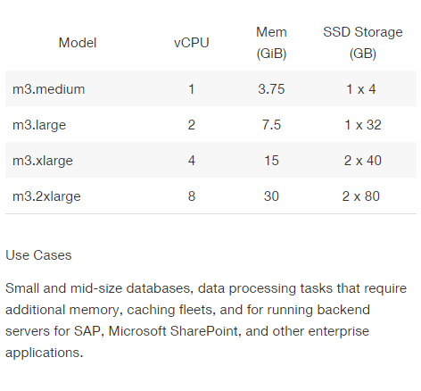
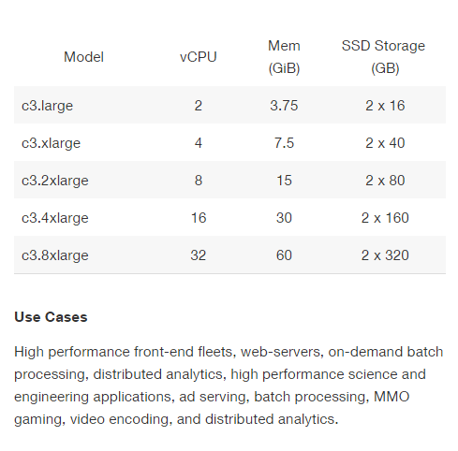
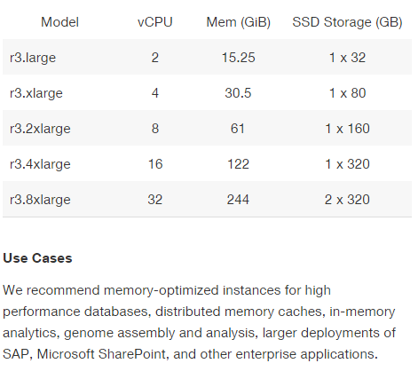

Slide 9
EC2 Pricing Model
Free Usage Tier
On-Demand Instances
  Start and stop instances whenever you like, costs are rounded up to the nearest hour. (Worst price)
Reserved Instances
  Pay up front for one/three years in advance. (Best price)
  Unused instances can be sold on a secondary market.
Spot Instances
  Specify the price you are willing to pay, and instances get started and stopped without any warning as the marked changes. (Kind of like Condor!)
http://aws.amazon.com/ec2/pricing/

Slide 10
Free Usage Tier
750 hours of EC2 running Linux, RHEL, or SLES t2.micro instance usage
750 hours of EC2 running Microsoft Windows Server t2.micro instance usage
750 hours of Elastic Load Balancing plus 15 GB data processing
30 GB of Amazon Elastic Block Storage in any combination of General Purpose (SSD) or Magnetic, plus 2 million I/Os (with Magnetic) and 1 GB of snapshot storage
15 GB of bandwidth out aggregated across all AWS services
1 GB of Regional Data Transfer

Slide 11
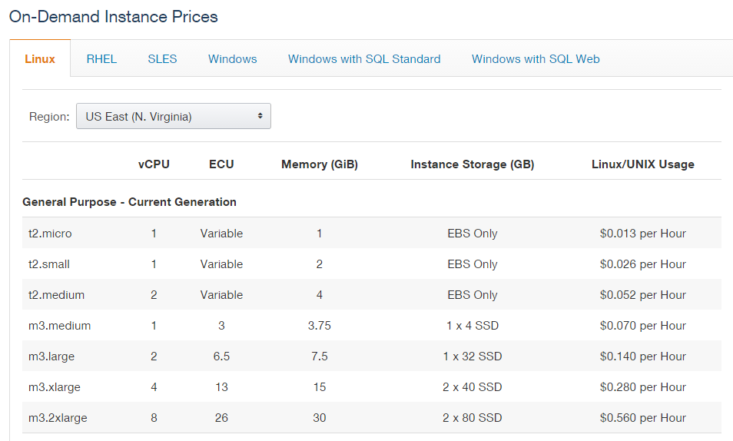

Slide 12
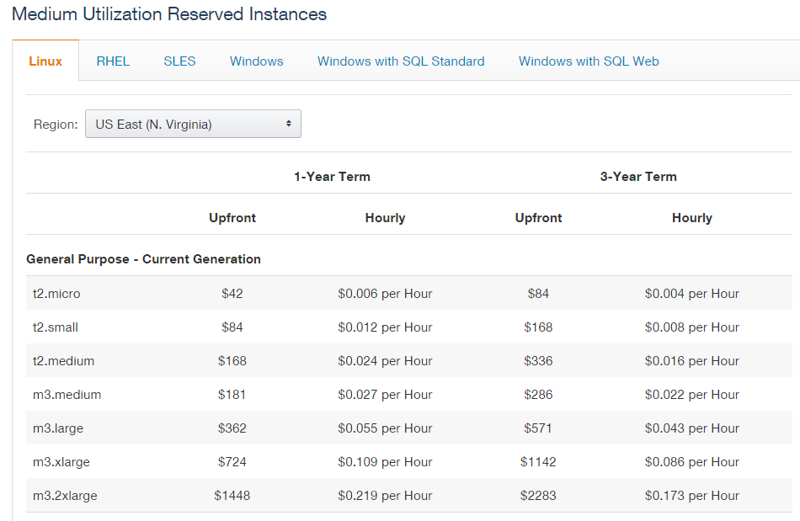

Slide 13
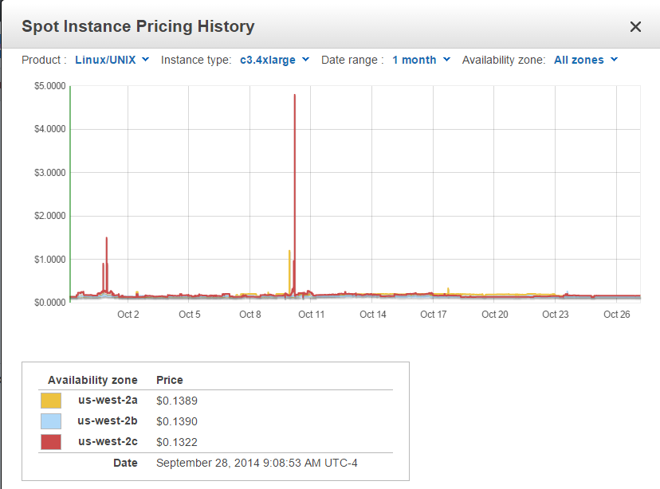

Slide 14
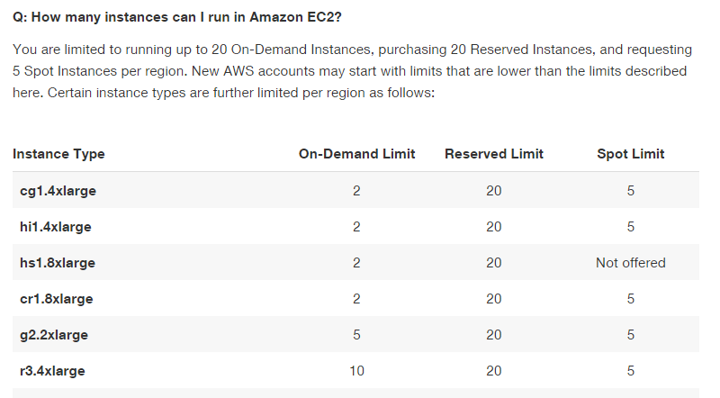
Surprisingly, you can’t scale up that large.

Slide 15
Simple Storage Service (S3)
A bucket is a container for objects and describes location, logging, accounting, and access control. A bucket can hold any number of objects, which are files of up to 5TB. A bucket has a name that must be globally unique.
Fundamental operations corresponding to HTTP actions:
  http://bucket.s3.amazonaws.com/object
  POST a new object or update an existing object.
  GET an existing object from a bucket.
  DELETE an object from the bucket
  LIST keys present in a bucket, with a filter.
A bucket has a flat directory structure (despite the appearance given by the interactive web interface.)

Slide 16
Easily Integrated into Web Applications
<form action="http://examplebucket.s3.amazonaws.com/" method="post" enctype="multipart/form-data">
<input type="input" name="key" value="user/user1/" />
<input type="hidden" name="acl" value="public-read" />
<input type="hidden" name="success_action_redirect"
value="http://examplebucket.s3.amazonaws.com/successful_upload.html" />
. . .
<input type="text" name="X-Amz-Credential”
value="AKIAIOSFODNN7EXAMPLE/20130806/us-east-1/s3/aws4_request" />
. . .
<input type="submit" name="submit" value="Upload to Amazon S3" /> </form>
http://docs.aws.amazon.com/AmazonS3/latest/API/sigv4-post-example.html

Slide 17
Bucket Properties
Versioning – If enabled, POST/DELETE result in the creation of new versions without destroying the old.
Lifecycle – Delete or archive objects in a bucket a certain time after creation or last access or number of versions.
Access Policy – Control when and where objects can be accessed.
Access Control – Control who may access objects in this bucket.
Logging – Keep track of how objects are accessed.
Notification – Be notified when failures occur.

Slide 18
S3 Weak Consistency Model
Direct quote from the Amazon developer API:
“Updates to a single key are atomic….”
“Amazon S3 achieves high availability by replicating data across multiple servers within Amazon's data centers. If a PUT request is successful, your data is safely stored. However, information about the changes must replicate across Amazon S3, which can take some time, and so you might observe the following behaviors:
  A process writes a new object to Amazon S3 and immediately attempts to read it. Until the change is fully propagated, Amazon S3 might report "key does not exist."
  A process writes a new object to Amazon S3 and immediately lists keys within its bucket. Until the change is fully propagated, the object might not appear in the list.
  A process replaces an existing object and immediately attempts to read it. Until the change is fully propagated, Amazon S3 might return the prior data.
  A process deletes an existing object and immediately attempts to read it. Until the deletion is fully propagated, Amazon S3 might return the deleted data.”

Slide 19
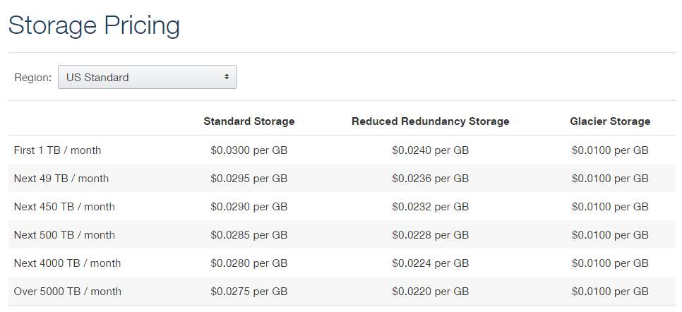

Slide 20
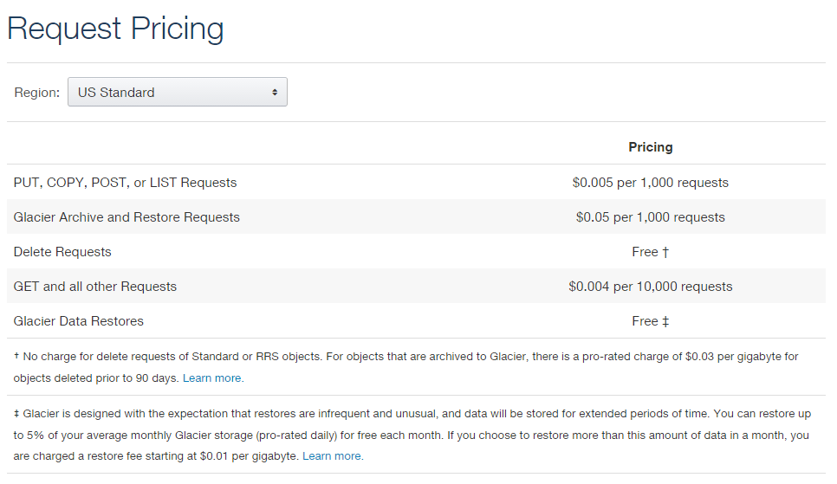

Slide 21
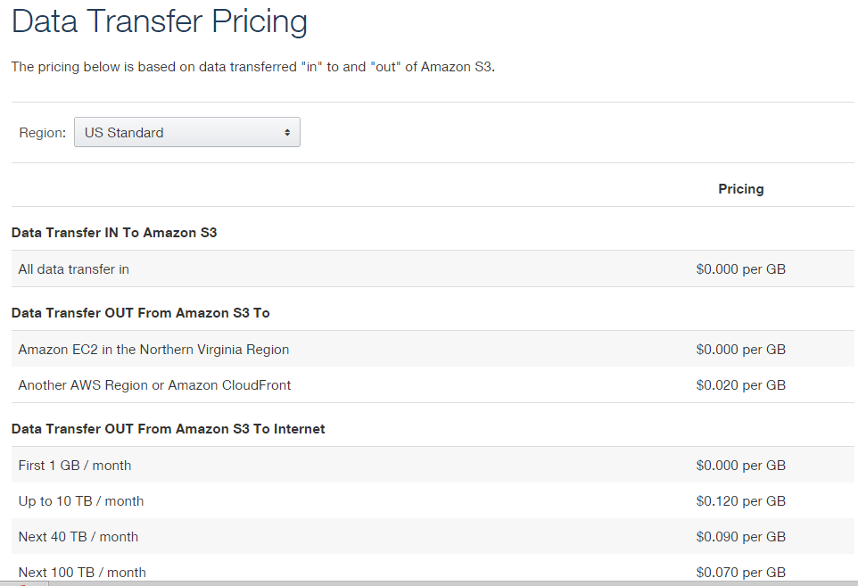

Slide 22
Elastic Block Store
An EBS volume is a virtual disk of a fixed size with a block read/write interface. It can be mounted as a filesystem on a running EC2 instance where it can be updated incrementally. Unlike an instance store, an EBS volume is persistent.
(Compare to an S3 object, which is essentially a file that must be accessed in its entirety.)
Fundamental operations:
  CREATE a new volume (1GB-1TB)
  COPY a volume from an existing EBS volume or S3 object.
  MOUNT on one instance at a time.
  SNAPSHOT current state to an S3 object.

Slide 23
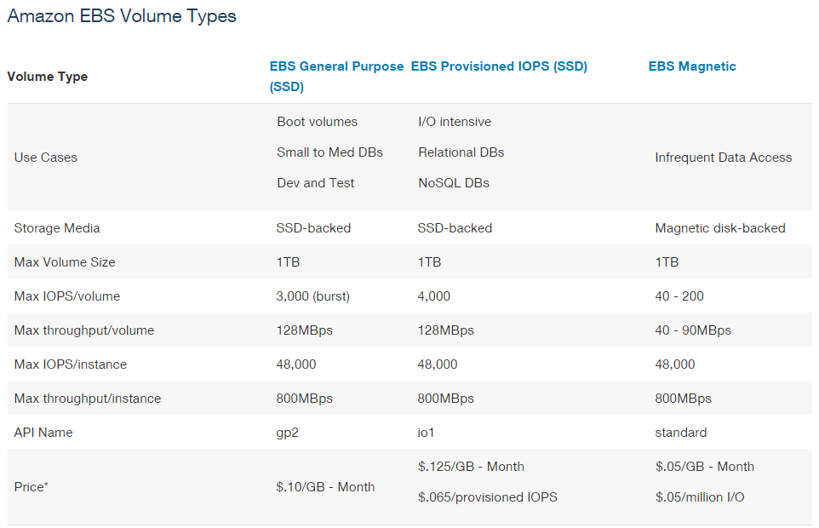

Slide 24
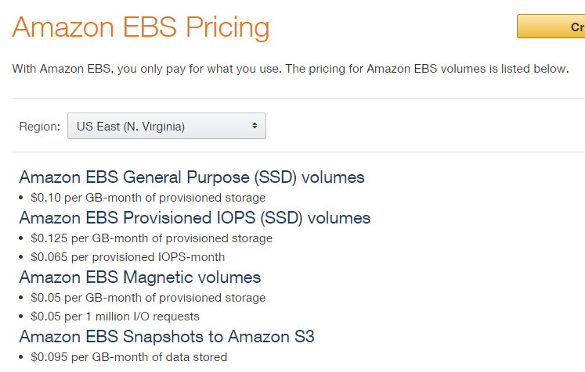

Slide 25
EBS is approx. 3x more expensive by volume and 10x more expensive by IOPS than S3.

Slide 26
Use Glacier for Cold Data
Glacier is structured like S3: a vault is a container for an arbitrary number of archives. Policies, accounting, and access control are associated with vaults, while an archive is a single object.
However:
  All operations are asynchronous and notified via SNS.
  Vault listings are updated once per day.
  Archive downloads may take up to four hours.
  Only 5% of total data can be accessed in a given month.
Pricing:
  Storage: $0.01 per GB-month
  Operations: $0.05 per 1000 requests
  Data Transfer: Like S3, free within AWS.
S3 Policies can be set up to automatically move data into Glacier.

Slide 27
Durability
Amazon claims about S3:
  Amazon S3 is designed to sustain the concurrent loss of data in two facilities, e.g. 3+ copies across multiple available domains.
  99.999999999% durability of objects over a given year.
Amazon claims about EBS:
  Amazon EBS volume data is replicated across multiple servers in an Availability Zone to prevent the loss of data from the failure of any single component.
  Volumes <20GB modified data since last snapshot have an annual failure rate of 0.1% - 0.5%, resulting in complete loss of the volume.
  Commodity hard disks have an AFR of about 4%.
Amazon claims about Glacier is the same as S3:
  Amazon S3 is designed to sustain the concurrent loss of data in two facilities, e.g. 3+ copies across multiple available domains PLUS periodic internal integrity checks.
  99.999999999% durability of objects over a given year.
Beware of oversimplified arguments about low-probability events!

Slide 28
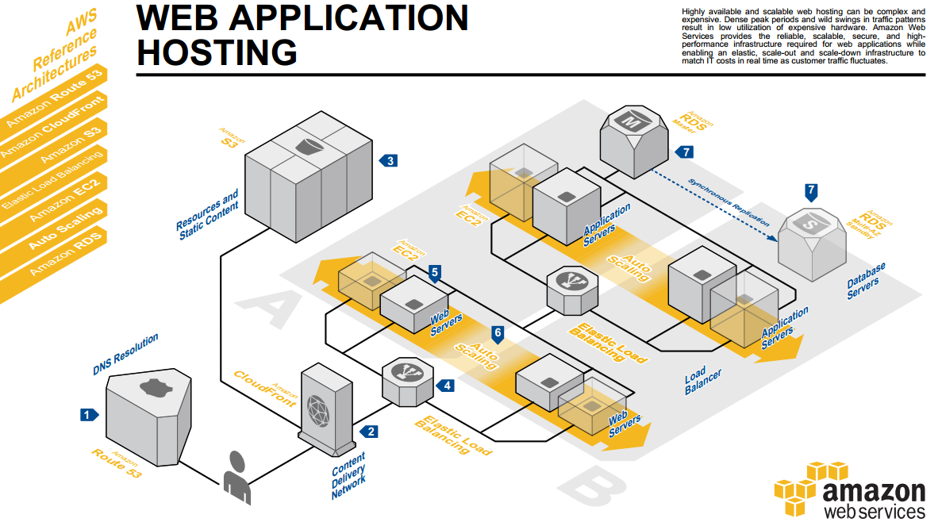
Architecture Center
Ideas for constructing large scale infrastructures using AWS:
http://aws.amazon.com/architecture/

Slide 29
Command Line Setup
Go to your profile menu (your name) in the upper right hand corner, select “Security Credentials” and “Continue to Security Credentials”
Select “Access Keys”
Select “New Access Key” and save the generated keys somewhere.
Edit ~/.aws/config and set it up like this:
Now test it: aws ec2-describe-instances
[default]
output = json
region = us-west-2
aws_access_key = XXXXXX
aws_secret_access_key = YYYYYYYYYYYY
Note the syntax here is different from how
it was given in the web console!
AWSAccessKey=XXXXXX
AWSSecretAccessKey=YYYYYYYYY

Slide 30
S3 Command Line Examples
aws s3 mb s3://bucket
. . . cp localfile s3://bucket/key
mv s3://bucket/key s3://bucket/newname
ls s3://bucket
rm s3://bucket/key
rb s3://bucket
aws s3 help
aws s3 ls help

Slide 31
EC2 Command Line Examples
aws ec2 describe-instances
run-instances --image-id ami-xxxxx -- count 1
--instance-type t1.micro --key-name keyfile
stop-instances --instance-id i-xxxxxx
aws ec2 help
aws ec2 start-instances help

Slide 32
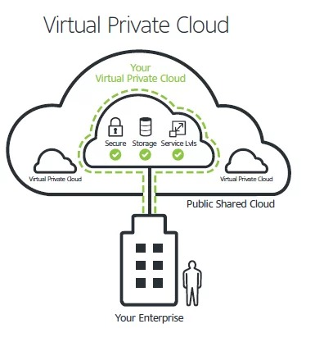
AMAZON VPC
What is amazon vpc ?
Amazon VPC enables you to connect your on-premises resources to AWS infrastructure through a virtual private network. This virtual network closely resembles a traditional network that you'd operate in your data center but enables you to leverage the scalable infrastructure in AWS.

Slide 33
WHY VPC ?
Amazon Virtual Private Cloud (Amazon VPC) provides a logically isolated area of the AWS cloud where you can launch AWS resources in a virtual network that you define.
You have complete control over your virtual networking environment, including a selection of your IP address range, the creation of subnets, and configuration of route tables and network gateways.

Slide 34
You can easily customize the network configuration for your Amazon Virtual Private Cloud. For example, you can create a public-facing subnet for web servers that can access to the internet and can also place your backend system such as databases or application servers to a private-facing subnet.
You can provide multiple layers of security, including security groups and network access control lists, to help control access to Amazon EC2 instances in each subnet.

Slide 35
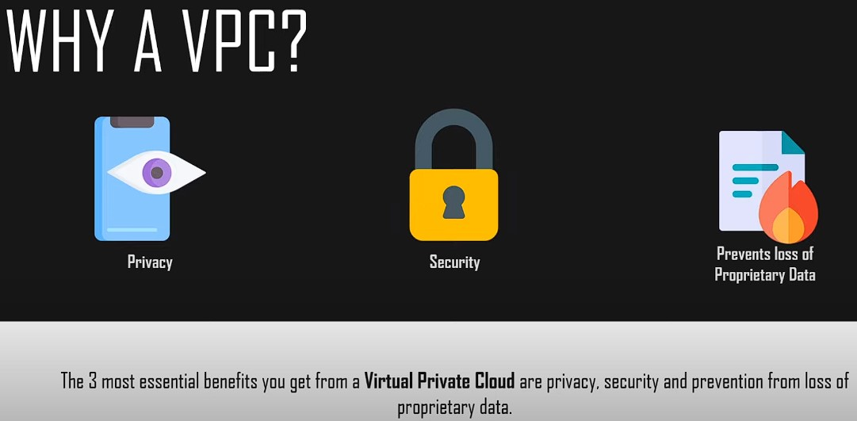

Slide 36
Difference between Private Cloud and Virtual Private Cloud
A private cloud is single-tenant a service exclusively offered to one organization.
A virtual private cloud is a private cloud within a public cloud.
While they sound similar, it’s important to note that the terms ‘private cloud’ and ‘virtual private cloud’ are not the same.
A private cloud runs on dedicated infrastructure which may reside on-premises in a dedicated off-premises data centre – or within a managed cloud vendor. Advantages of a private cloud include control and exclusivity. There are no neighbours to share hosted resources with.

Slide 37
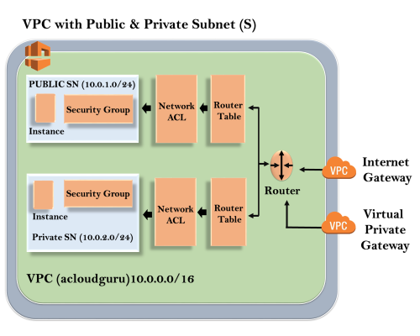
Architecture of VPC

Slide 38
The outer line represents the region, and the region is us-east-1. Inside the region, we have VPC, and outside the VPC, we have internet gateway and virtual private gateway.
Internet Gateway and Virtual Private Gateway are the ways of connecting to the VPC. Both these connections go to the router in a VPC and then router directs the traffic to the route table.
Route table will then direct the traffic to Network ACL. Network ACL is the firewall or much like security groups.
Network ACL are state list which allows as well as deny the roles. You can also block the IP address on your Network ACL.

Slide 39
Now, move over to the security group that accesses another line against the EC2 instance. It has two subnets, i.e., Public and Private subnet. In public subnet, the internet is accessible by an EC2 instance, but in private subnet, an EC2 instance cannot access the internet on their own. We can connect the instances. To connect an instance, move over to the public subnet and then it SSH to the private subnet. This is known as jump boxes. In this way, we can connect an instance in public subnet to an instance in private subnet.

Slide 40
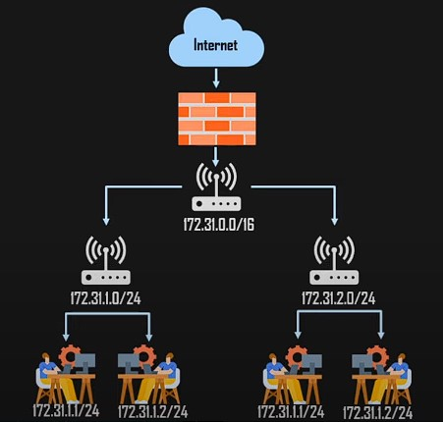
COMPONETS OF VPC
1. SUBNET
A SUBNET IS A LOGICAL DIVISION OF A LARGER NETWORK.
IT IS A SMALLER PORTION OF THE NETWORK THAT TYPICALLY INCLUDES ALL THE MACHINES IN A CERTAIN AREA.
WE CAN ADD AS MANY AS SUBNETS WE NEED IN ONE AVAILABILITY ZONE. EACH SUBNET MUST RESIDE ENTIRELY WITHIN ONE AVAILABILITY ZONE.
THE PUBLIC SUBNETS WILL BE ATTACHED TO INTERNET GATEWAY WHICH ENABLES INTERNET ACCESS.
THE PRIVATE SUBNETS WILL NOT HAVE INTERNET ACCESS.
EACH AND EVERY SUBNET WHICH IS PRESENTED IN VPC MUST BE ASSOCIATED WITH THE ROUTING TABLE.

Slide 41
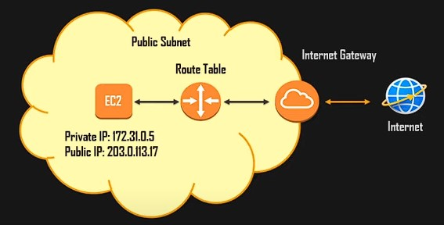
COMPONETS OF VPC
2. INTERNET GATEWAY
THE INTERNET GATEWAY IS A VPC THAT HELPS INSTANCES TO COMMUNICATE OVER THE INTERNET USING TARGET PROVIDED IN THE ROUTE TABLE.
WITH THE HELP OF IGW (INTERNET GATEWAY), THE RESOURCES PRESENT (E.G: EC2) IN THE VPC WILL ENABLE TO ACCESS THE INTERNET.
ONE VPC CAN’T HAVE MORE THAN ONE IGW

Slide 42
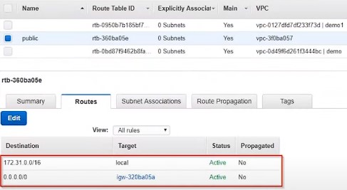
COMPONETS OF VPC
3. ROUTE TABLE
ROUTE TABLE CONTAINS A SET OF RULES, CALLED ROUTE WHICH HELPS US TO ROUTE THE NETWORK TRAFFIC.
A SINGLE VPC CAN HAVE AS MANY AS ROUTE TABLES IT REQUIRES.
IF THE DEPENDENCIES ARE ATTACHED TO THE ROUTE TABLE THEN THEY CAN’T BE DELETED.

Slide 43
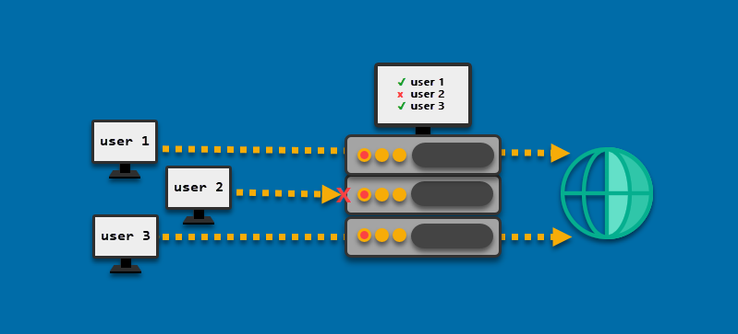
COMPONETS OF VPC
4. NETWORK ACCESS CONTROL
THE NACL SECURITY LAYER FOR VPC SERVES AS A FIREWALL TO MANAGE TRAFFIC ENTERING AND LEAVING ONE OR MORE SUBNETS.
THE NACL FOR THE DEFAULT VPC IS ACTIVE AND CONNECTED TO THE DEFAULT SUBNETS.

Slide 44
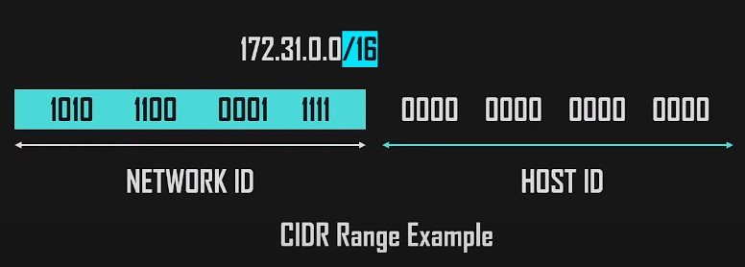
COMPONETS OF VPC
5. CLASSLESS INTER-DOMAIN ROUTING (CIDR)
A TECHNIQUE FOR ALLOCATING IP ADDRESSES AND FOR IP ROUTING IS CALLED CLASSLESS INTER-DOMAIN ROUTING (CIDR), AND ITS RANGE IS 0-32.
WHEN SETTING UP A VPC, WE MUST SPECIFY A SET OF IPV4 ADDRESSES USING CLASSLESS INTER-DOMAIN ROUTING (CIDR), FOR (EXAMPLE:10.0.0.0/16 FOR OUR VPC, THIS WILL SERVE AS THE MAIN CIDR BLOCK).

Slide 45
BENEFITS OF VPC
Amazon Private Cloud offers advanced security features including security groups and network access controls
AWS Virtual Private Cloud is easy to deploy and manage via the AWS Management Console
Ability to simplify workload cloud migration with VMware (virtual machines) Cloud on AWS
Customizable in allowing users to select their own IP address ranges and create subnet as well as configure route tables and network gateways. AWS also accommodates DNS (Domain Name Systems) via a DNS server
Amazon Private Cloud is charged on an hourly basis

Slide 46
Use cases of vpc
Using VPC, you can host a public-facing website, a single-tier basic web application, or just a plain old website.
The connectivity between our web servers, application servers, and database can be limited by VPC with the help of VPC peering.
By managing the inbound and outbound connections, we can restrict the incoming and outcoming security of our application.

Slide 47
What is Amazon Route 53 ?
AWS Route 53 is a highly available and scalable DNS web service. It gives businesses and developers a cost-effective way to route end users to internet applications by translating the domain names into IP addresses

Slide 48
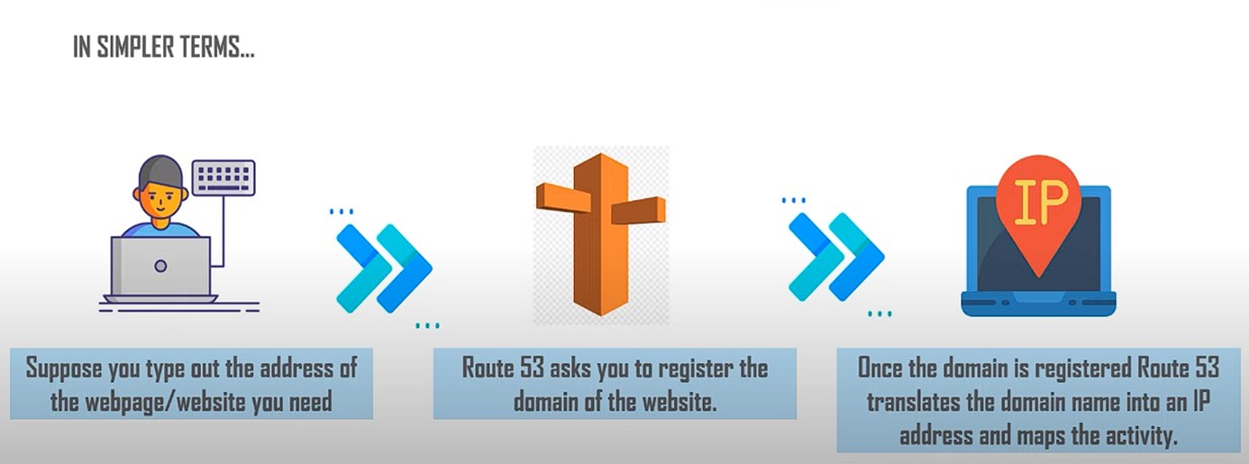

Slide 49
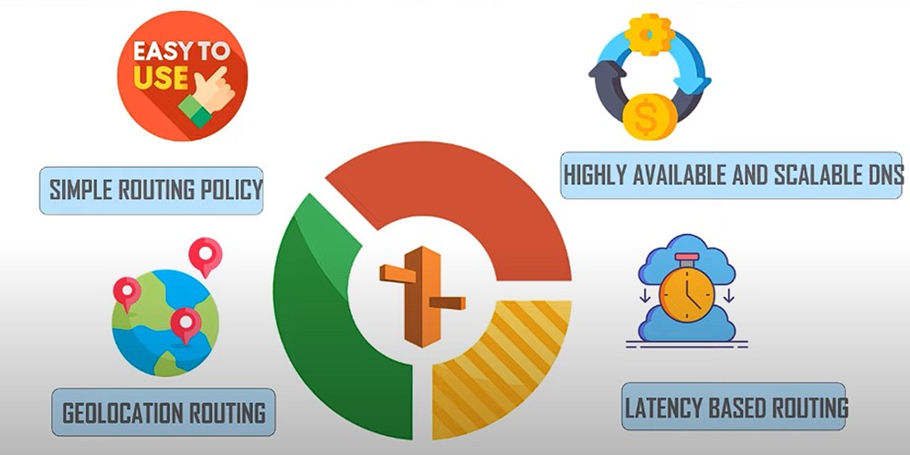
Why do we use Amazon Route 53 ?

Slide 50
Working of Route 53
The global infrastructure called the Domain Name System (DNS) translates human-readable hostnames into numerical IP addresses. IP addresses on the cloud can change frequently, as services move between data centers and physical machines. This means the translation and communication process is complex.
Organizations that run machines in the cloud using Amazon Web Services (AWS) need an AWS DNS solution—a way to correctly translate user requests into Amazon IP addresses while adapting to cloud changes and quickly propagating them to DNS clients.
AWS Route 53 is Amazon’s official DNS solution.

Slide 51
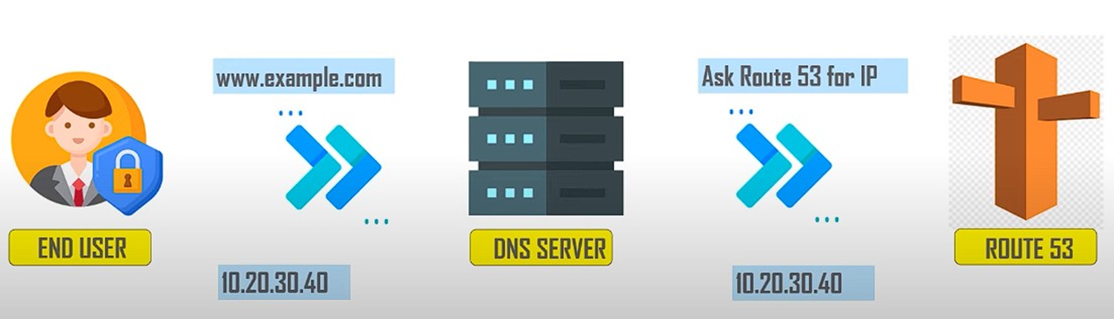

Slide 52
A user accesses an address managed by Route 53, www.website.com, which leads to an AWS-hosted machine.
Typically managed by the local network or ISP, the user’s DNS resolver receives the request for www.website.com routed by AWS Route 53 and forwards it to a DNS root server.
The DNS resolver forwards the TLD name servers for “.com” domains the user requests.
The resolver acquires the four authoritative Amazon Route 53 name servers that host the domain’s DNS zone.
The DNS resolver selects one of the four AWS Route 53 servers, and requests details for www.website.com.
The Route 53 name server searches the DNS zone for the www.website.com IP address and other relevant information and returns it to the DNS resolver.
As specified by the Time to Live (TTL) parameter, the DNS resolver caches the IP address locally, and of course returns it to the user’s web browser.
The browser uses the IP address the resolver provides to contact Amazon-hosted services such as the web server.
The user’s web browser displays the website.

Slide 53
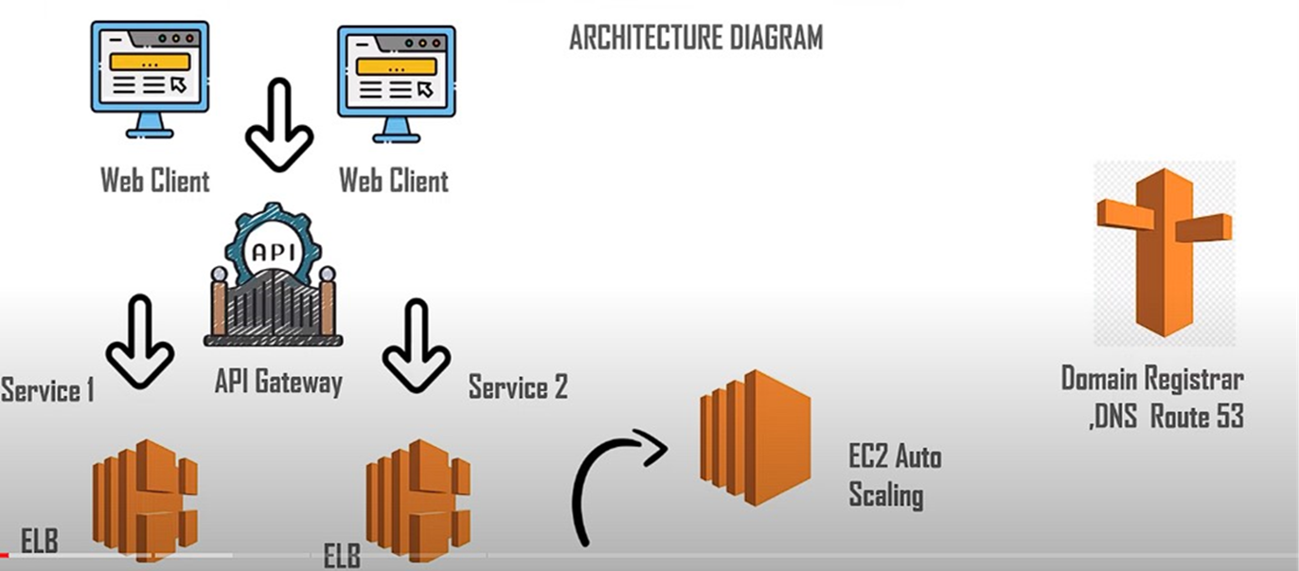

Slide 54
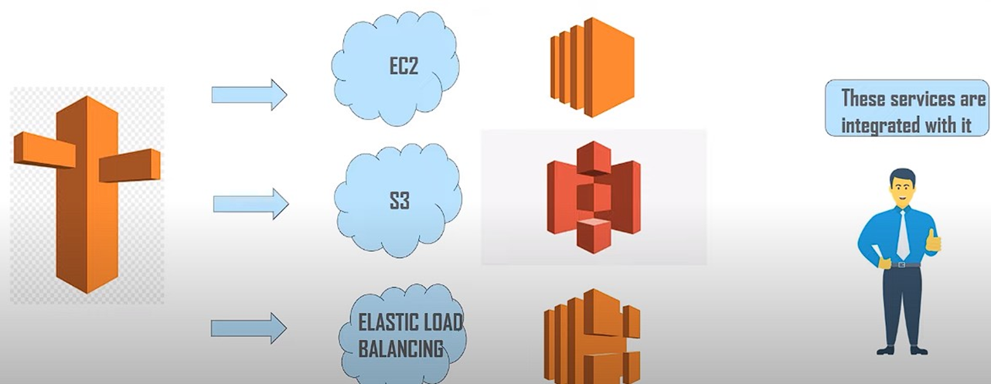

Slide 55
Features of AWS Route 53
1. Route 53 Resolver :
AWS Route 53 Resolver is a service that helps you resolve domain names within your Amazon Virtual Private Cloud (VPC) or on-premises network. It enables DNS resolution for your resources, allowing you to route traffic both within your VPC and to external resources, like the internet.

Slide 56
2. Application Recovery Resolver :
This is a feature within Route 53 Resolver that helps improve the availability of your applications. It automatically detects when your DNS resolvers are experiencing issues and reroutes DNS traffic to healthy resolvers, ensuring your applications remain accessible and reliable.

Slide 57
3. Traffic Flow :
Traffic Flow is a feature in AWS Route 53 that allows you to control and manage the routing of your DNS traffic. It enables advanced traffic management by letting you create routing policies, set up failover configurations, and implement weighted routing to distribute traffic across multiple resources for high availability and load balancing.

Slide 58
4. Geo DNS :
Geo DNS, also known as Geolocation-based DNS, is a feature that allows you to route DNS requests based on the geographical location of the requesting client. This helps optimize the user experience by directing users to the nearest or most appropriate server or content delivery network (CDN) based on their geographic location.

Slide 59
5. Health Check and Monitoring :
Route 53 provides health checks and monitoring capabilities that allow you to ensure the availability and performance of your applications and resources. You can set up health checks to monitor the health of endpoints such as web servers, and Route 53 can automatically route traffic away from unhealthy endpoints.

Slide 60
6. Domain Registration :
AWS Route 53 offers domain registration services, allowing you to register and manage domain names (e.g., example.com). It simplifies the process of buying and managing domain names, including features like automatic renewals, DNS management, and integration with other AWS services for easy setup of your websites and applications.

Slide 61
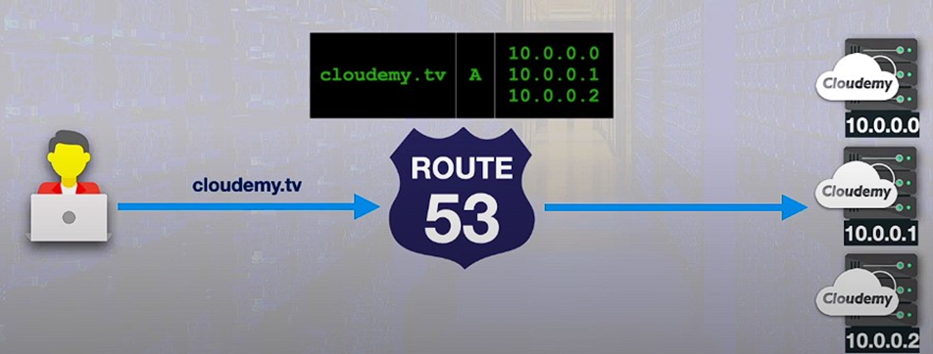
Types of Routing Policies
1. Simple Routing Policy
Used for a single resource that performs a given function for your domain. Like the web server that serves content for your website

Slide 62
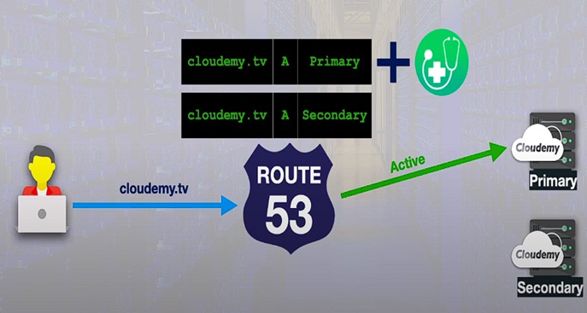
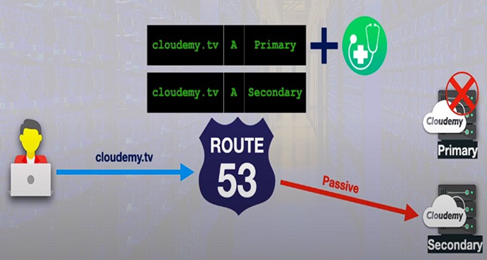
2. Failover Routing Policy
This policy comes into use when you want to configure the active- passive failover. Failover occurs when system automatically transfers control to another system

Slide 63
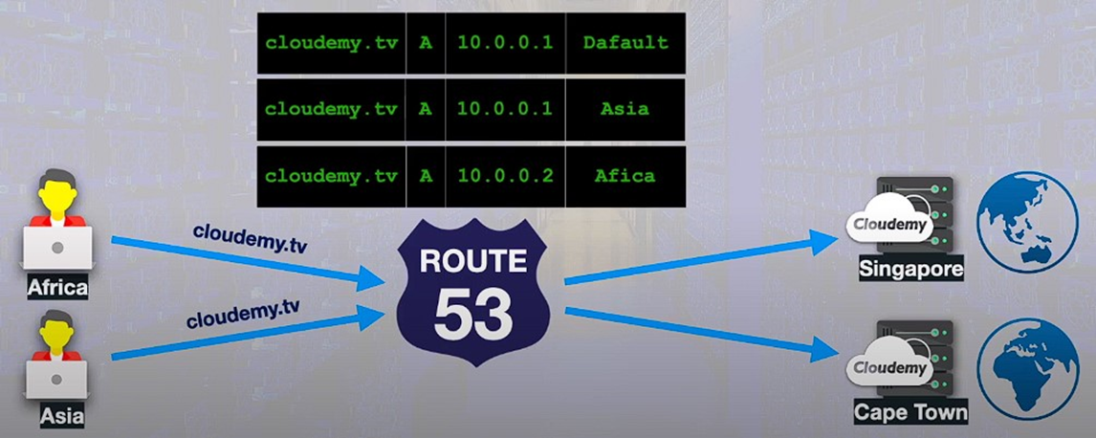
3. Geo Location Routing Policy
Geolocation routing policy is generally used when you want to route traffic based on the location of your users. It can be from a particular location or global.

Slide 64
4. Geo Proximity Routing Policy
Use this when you want to route traffic based on the location of your resources and optionally shift traffic from resources in one location to resources in another.

Slide 65
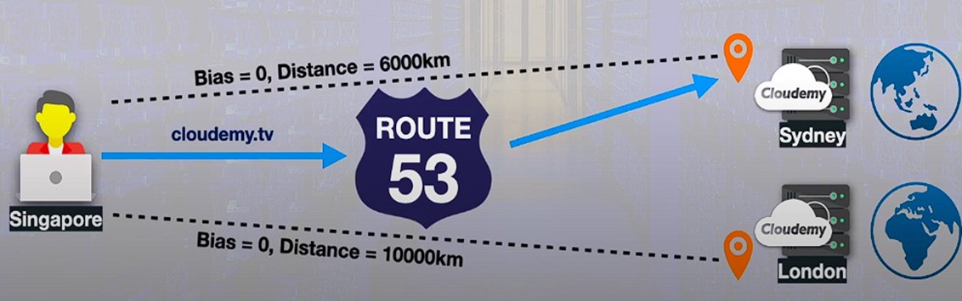
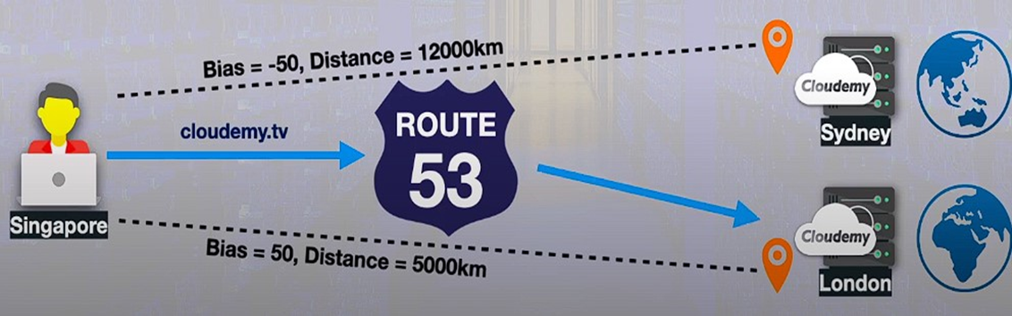

Slide 66
5. Latency Routing Policy
Use this policy when you have resources in multiple AWS regions and you want to route traffic to the region that provides the best latency and less round trip time.

Slide 67
Benefits of AWS Route 53
Highly Available and Reliable
Flexible
Simple
Fast
Cost-effective
Designed to Integrate with Other AWS Services
Secure
Scalable

Slide 68
Use cases of AWS Route 53
Website Hosting
Route 53 can be used to route traffic to your web servers or hosting resources, ensuring that your website is accessible using your domain name.
Load Balancing
You can use Route 53 to distribute incoming traffic across multiple AWS resources, such as EC2 instances, Elastic Load Balancers (ELB), or AWS Global Accelerator, to achieve load balancing and high availability.

Slide 69
Failover and Disaster Recovery
Implement failover configurations using Route 53 to automatically direct traffic to a backup or secondary site or resource in case the primary site becomes unavailable due to issues like server failure or regional outages.
Content Delivery
Route 53 can route traffic to content delivery networks (CDNs) like Amazon CloudFront, improving the delivery of static and dynamic content to end users worldwide.
Geolocation-Based Routing
Customize the user experience by routing traffic to specific resources based on the geographic location of the user. This is useful for serving region-specific content or applications.

